Slide 1
DDJ-1000 Traktor mapping installation
This work requires the “BOME Midi translator Pro” third-party software
Steps are first explained in a single page, then followed by detailed screenshots
Do not skip any step!
See also the installation FAQ (this a separate pdf file)

Slide 2
Step #0
CONFIRM THAT REKORDBOX DJ WORKS IN YOUR SYSTEM!
Driver Download: https://www.pioneerdj.com/en/support/software/controller/ddj-1000/#drivers
Firmware download: https://www.pioneerdj.com/en/support/software/controller/ddj-1000/#firmware-update
Rekordbox DJ download: https://rekordbox.com/en/

Slide 3
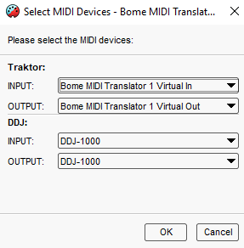
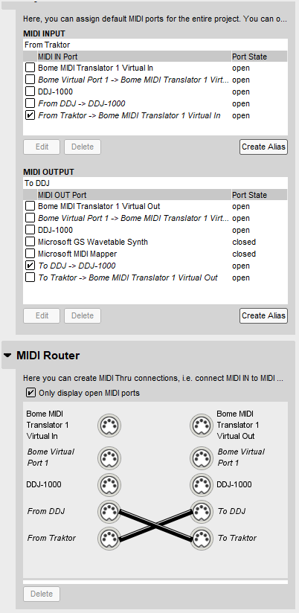
TRAKTOR DJ Software
AUDIO path
DDJ-1000
OS Driver
USB
TSI FILE (6 sub pages)
MIDI path
out port
DDJ-1000
in port
BMT1
From Traktor
To DDJ
To Traktor
BMTP file (7 presets)
From DDJ
BOME MIDI Translator
Settings
BMTS file

Slide 4
Step #1
BOME-MAP INSTALLATION do not skip any step!

Slide 5
PRELIMINARIES:
Stop Rekordbox
Stop Traktor
Expand all files in the zip file
Connect the USB cable
Turn on your DDJ-1000.
Download and Install the BOME trial from https://www.bome.com/products/miditranslator#downloads
INSTALLING BOME MAPPING:
Open BOME. DO NOT RUN TRAKTOR!
Settings: Import the settings file
Method: menu View; settings; export/import; import; select BMTS file
Mapping: load the mapping file
Method: Click menu File; Open; select BMTP file
Do not mix up the Settings file with the Mapping file!
Beware!

Slide 6
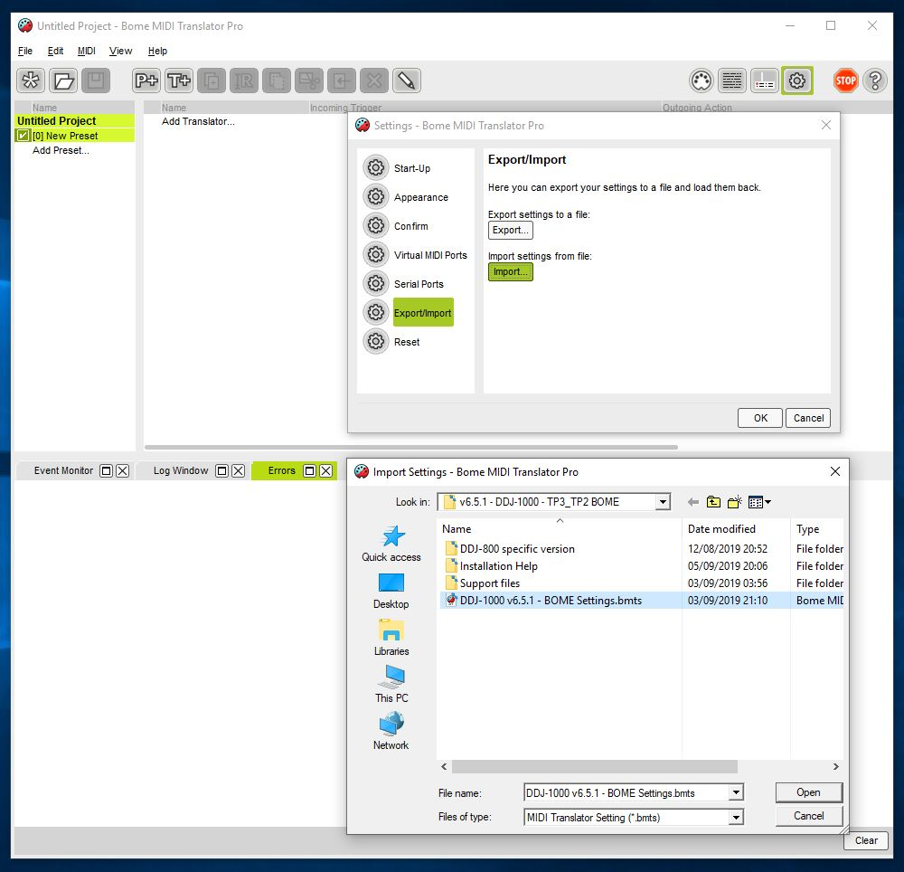
BOME: import settings file (BMTS file)

Slide 7
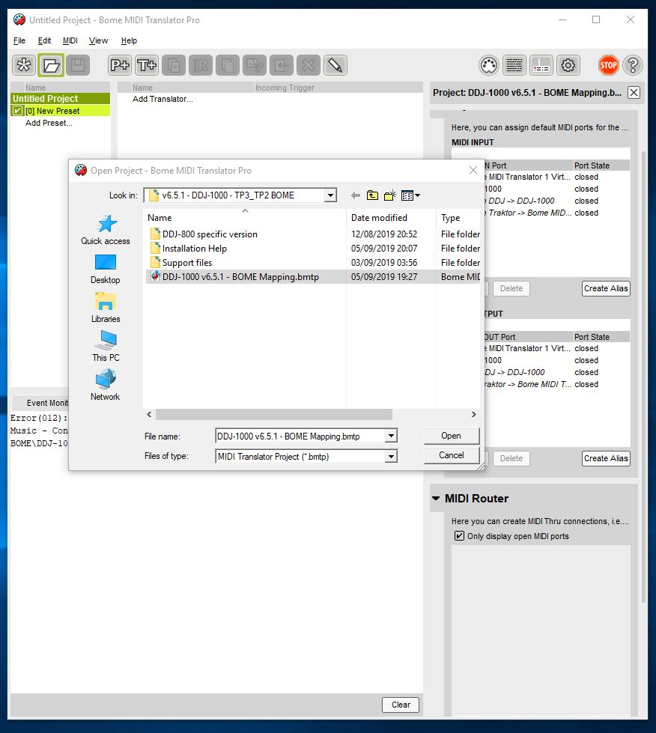
BOME: import mapping file (BMTP file)

Slide 8
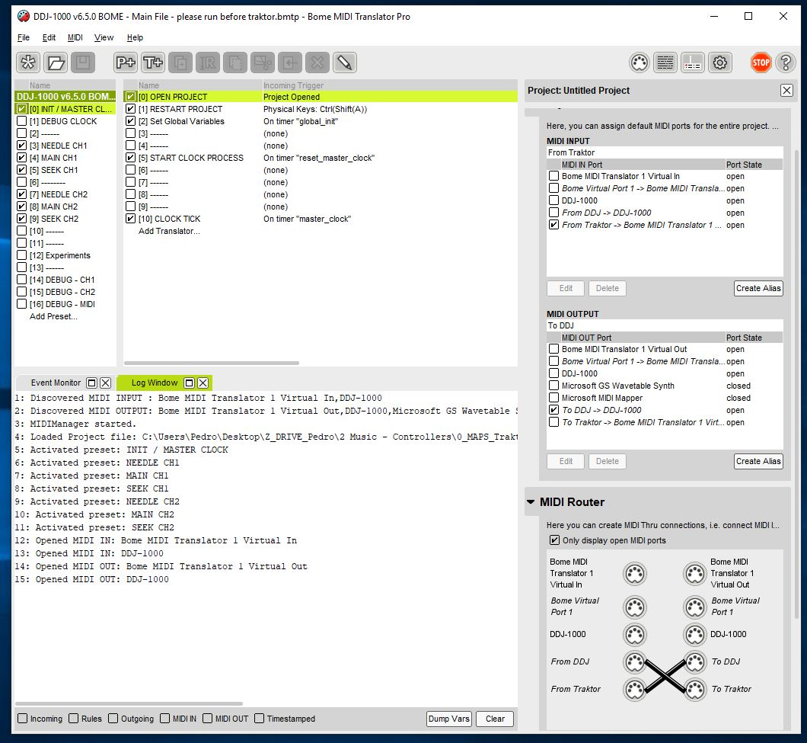
BOME: Devices
confirm the devices are OPEN!
Default is ONLY : - “From Traktor” OPEN - “to DDJ” OPEN
If you have problems here confirm tat Rekordbox Performance works in your system

Slide 9
BOME: Aliases

Slide 10
Step #2
BOME-MAP VERIFICATION
do not skip any step!

Slide 11
BOME VERIFICATION:
Confirm the BMT1 device is created (short format)
Method: menu View ; settings ; virtual midi ports ; 1 port; short port names
Confirm 4x midi ports are opened correctly
Method: Click log window; check log
Confirm DDJ talks to BOME
Method: Click log window; click “MIDI-IN/OUT”; Press any button on the controller; confirm they appear in the log file; unclick “MIDI-IN/OUT”
Confirm the BOME clock is running
Method: Click log window; click “rules”; see lots of messages flowing; unclick “rules”
Minimize BOME to keep it running

Slide 12
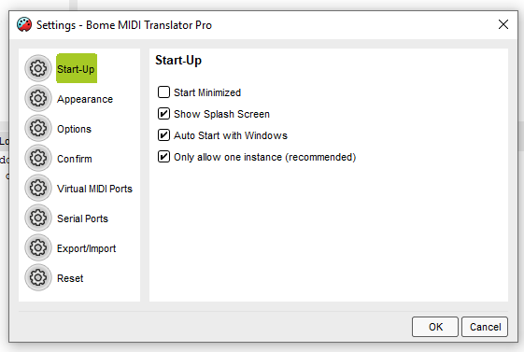
BOME settings: auto start with windows
Auto start with Windows!

Slide 13
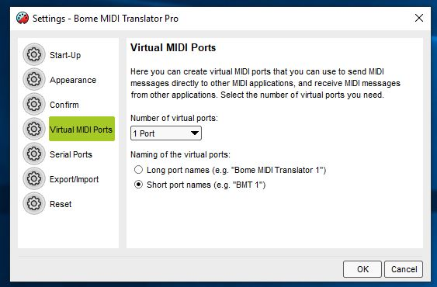
BOME settings: device “BMT1”
Short port names!

Slide 14
BOME: Correct startup log
Do not change this! Default is ONLY - “From Traktor” OPEN - “to DDJ” OPEN confirm devices are OPEN!
4x messages here!
Do not change this “cross”!

Slide 15
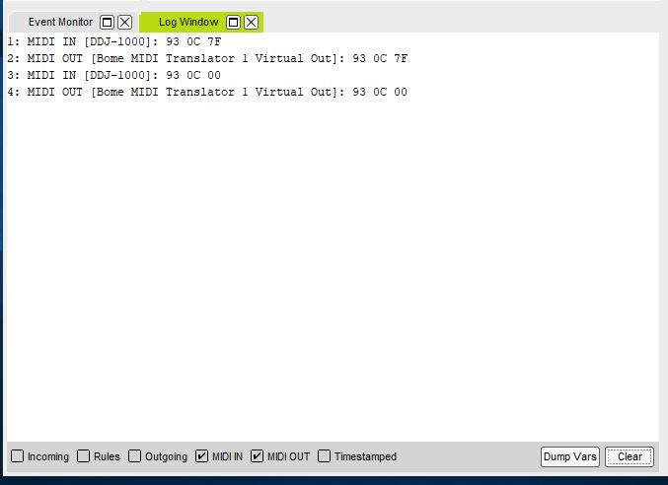
BOME: confirm DDJ talks to BOME
Pressing and releasing any button generates 4 log lines. This is always in the DDJ->BMT1 direction
Activate MIDI debug here

Slide 16
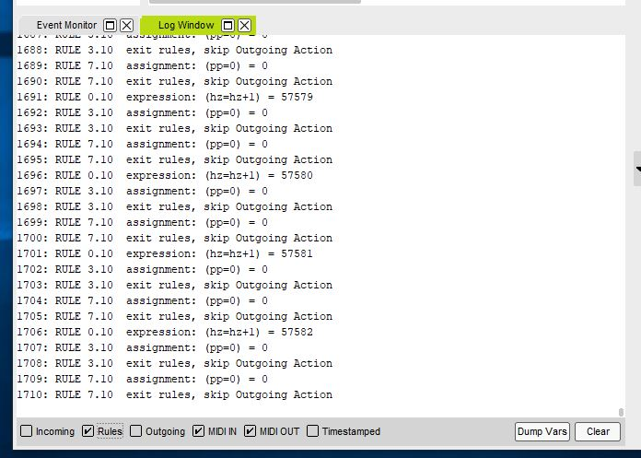
BOME: confirm internal clock
HZ goes up one by one continuously
Activate rules debug here
(Please click “rules” again to stop the logging)
Tip!

Slide 17
Step #3
TRAKTOR-MAP INSTALLATION do not skip any step!

Slide 18
INSTALL TRAKTOR MAPPING:
Open Traktor
Click Settings
Click big “import button” on lower left corner
Accept all check settings, PLUS additionally the “Audio device settings”
Repeat the mapping installation a second time.
This is only requires to confirm the FX list is correct
(this is a Traktor bug that is going on for years)!

Slide 19
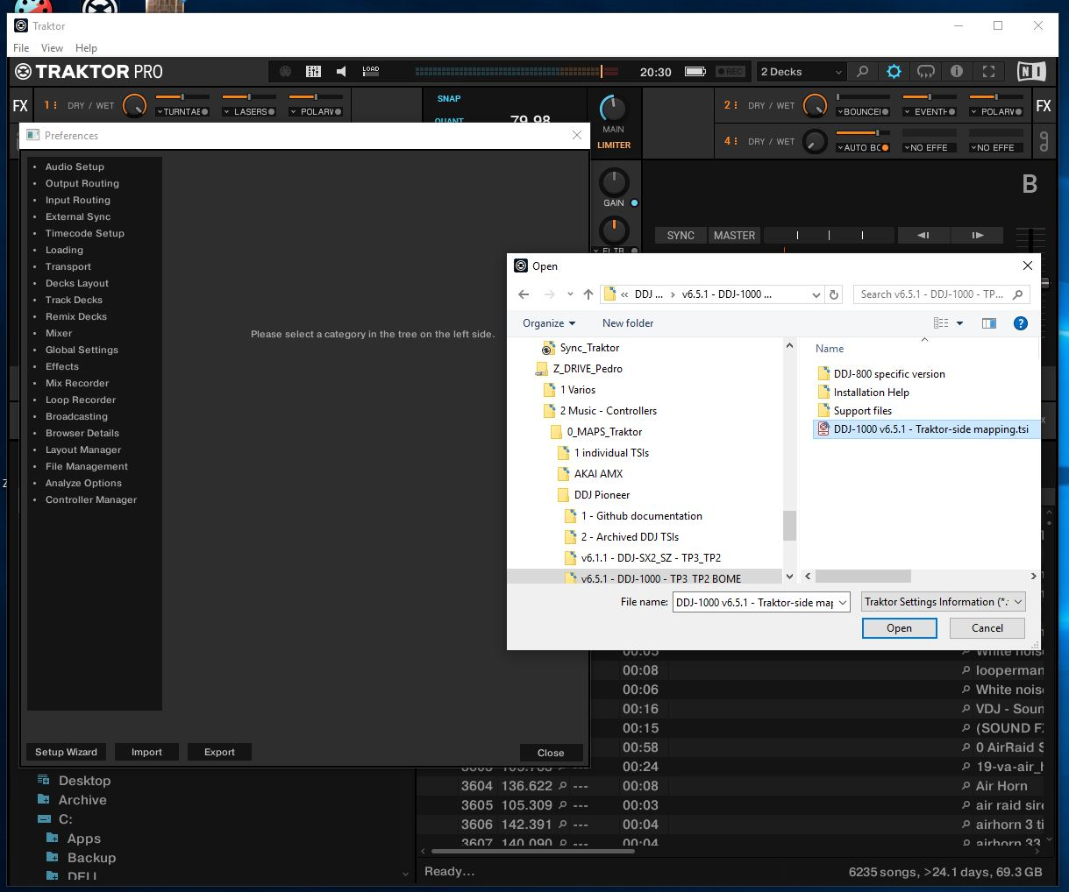
TRAKTOR: import mapping

Slide 20
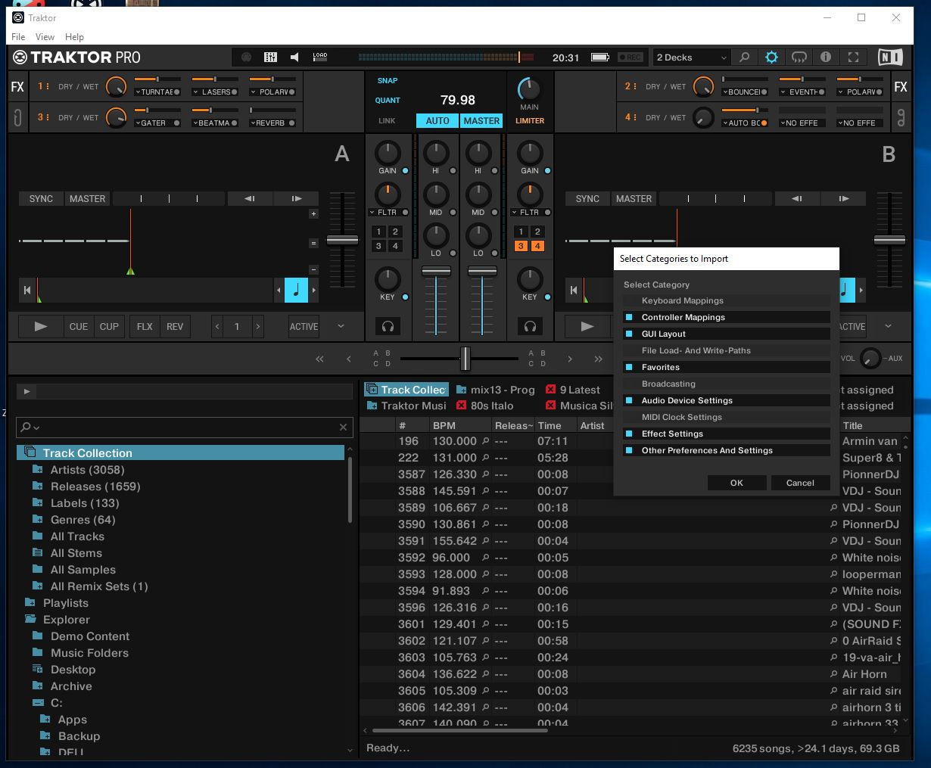
TRAKTOR: add audio device config
Please include this one

Slide 21
TRAKTOR: import mapping (second time)

Slide 22
TRAKTOR: add audio device config (second time)
Please include this one

Slide 23
Step #4
TRAKTOR-MAP VERIFICATION do not skip any step!

Slide 24
TRAKTOR VERIFICATION:
Note: the Preferences window is now quite slow to open. This is a known Traktor bug.
Confirm the audio device is “DDJ-1000 ASIO”
Method: Settings ; audio setup ; confirm audio device
Confirm that all 6x pages have exactly “BMT1”
Method: Settings; controller manager; click each of the 6x pages one-by-one; check IN and OUT port
DO NOT SET DDJ-1000 in the controller manager!!!
DO NOT FORGET TO CONFIRM ALL 6x PAGES
Verify that sound is played
Method: Load a track; click Cue and play/pause repeatedly
Use shift+quantize to send a reset command to BOME
Verify that BOME sees all the messages
Method: open the bome window; click the “CUE” button; verify that the BOME log displays at least 8x log lines per human click
#1 problem!!
#2 problem!!

Slide 25
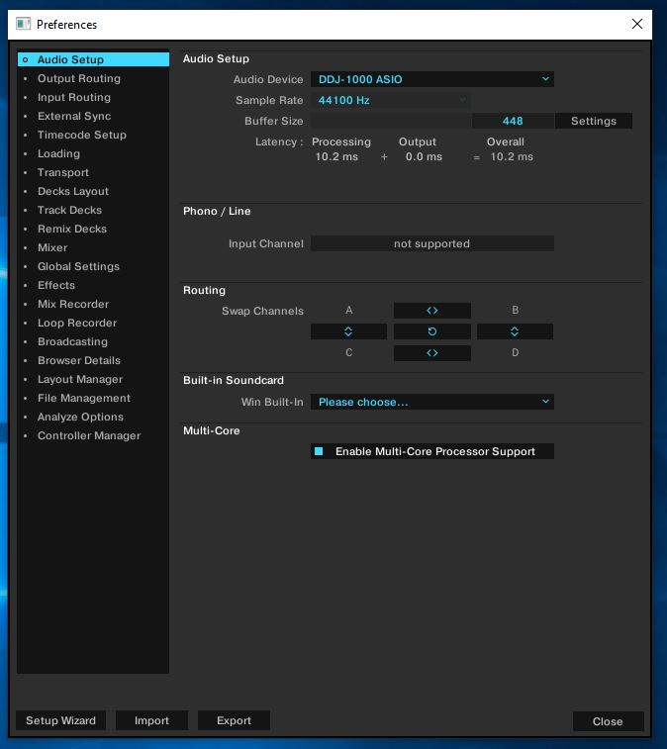
TRAKTOR: check audio device

Slide 26
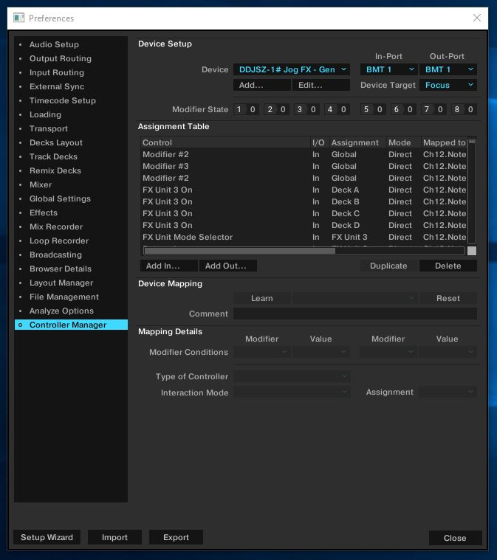
TRAKTOR: MIDI via “BMT1”
Both IN and OUT = “BMT1”
For ALL 6 PAGES!

Slide 27
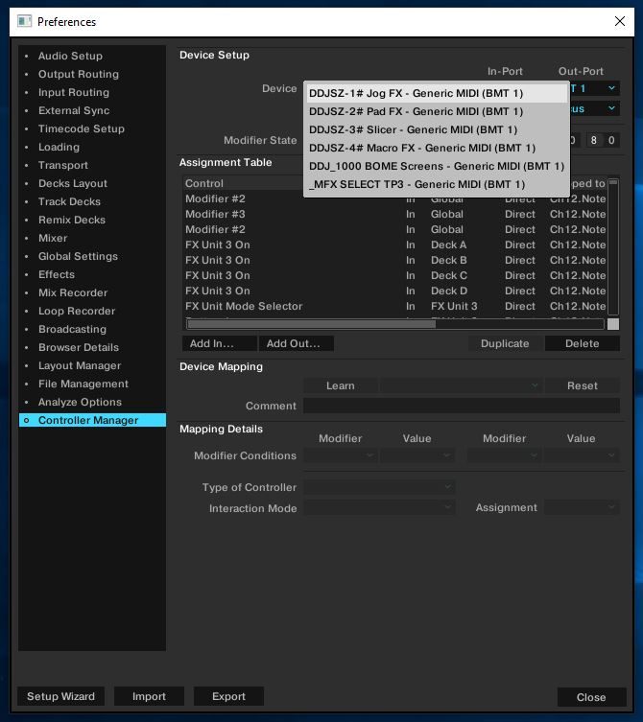
TRAKTOR: MIDI via “BMT1”
ALL 6 PAGES WITH BMT1!

Slide 28
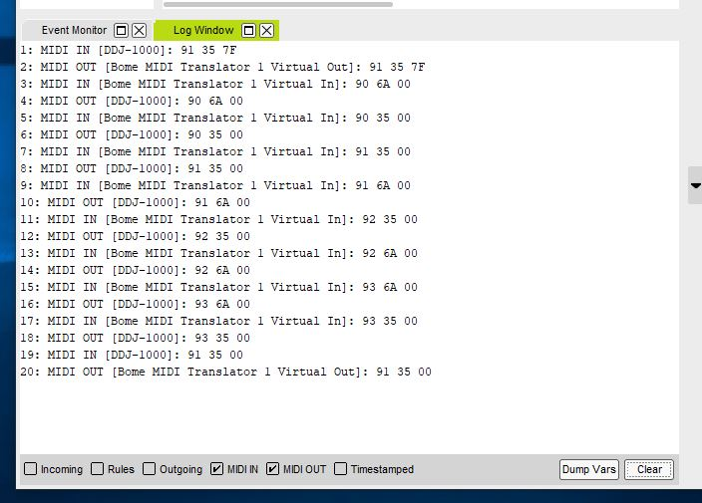
BOME: confirm bidirectional flow
Pressing and releasing any button generates at least 8x log lines. This is both in the DDJ->BMT1 direction and the BMT1->DDJ direction
Stop “rules” log

Slide 29
IF ITS STILL NOT WORKING #1
Do the reboot and confirm you have shortports (“BMT1”) in all 6 pages. If still having long ports, set “Bome midi Translator” manually to all 6 pages

Slide 30
IF ITS STILL NOT WORKING #2
Make a HD video of the verification steps, INCLUDING THE BOME LOG.
Upload the video to https://wetransfer.com so that I can read the small text Send an email to pedro.estrela@gmail.com

